Slide 1
Physics Informed Neural Network

Slide 2
Introduction
Generating accurate model of a complex physical system requires large amount of solution data.
Large amount of data collection from experiments is often infeasible or too costly.
PINN augments surrogate models using existing knowledge about underlying physical problem.
Physics of a system usually portrayed by differential governing equations.
Incorporating physics will drastically reduces the solution space, resulting in reduction of training data set.
General idea is that PINN is to be used where data availability is limited

Slide 3
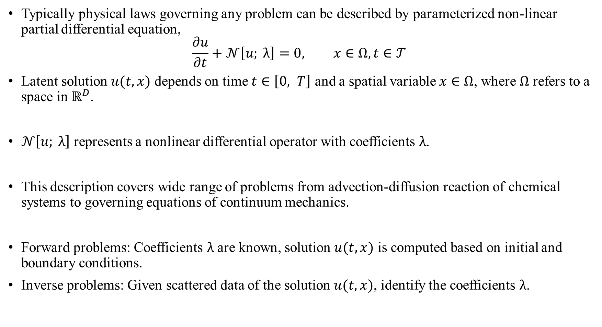
Overview
Typically physical laws governing any problem can be described by parameterized non-linear partial differential equation,
$$\frac{∂u}{∂t}+𝒩\left[u; λ\right]=0, x∈Ω, t∈𝒯$$
Latent solution $u(t,x)$ depends on time $t∈\left[0, T\right]$ and a spatial variable $x∈Ω$, where $Ω$ refers to a space in $ℝ^{D}$.
$𝒩\left[u; λ\right]$ represents a nonlinear differential operator with coefficients $λ$.
This description covers wide range of problems from advection-diffusion reaction of chemical systems to governing equations of continuum mechanics.
Forward problems: Coefficients $λ$ are known, solution $u(t,x)$ is computed based on initial and boundary conditions.
Inverse problems: Given scattered data of the solution $u(t,x)$, identify the coefficients $λ$.

Slide 4
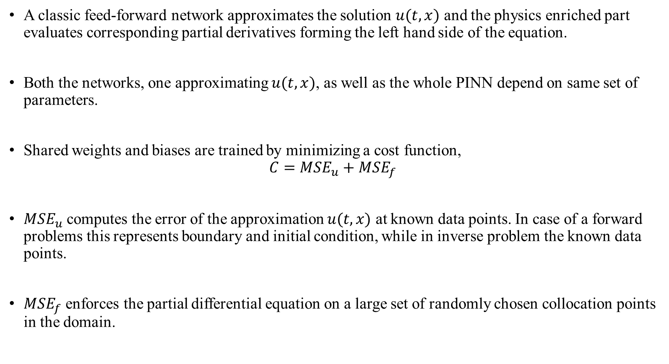
Overview
A classic feed-forward network approximates the solution $u(t,x)$ and the physics enriched part evaluates corresponding partial derivatives forming the left hand side of the equation.
Both the networks, one approximating $u(t,x)$, as well as the whole PINN depend on same set of parameters.
Shared weights and biases are trained by minimizing a cost function,
$$C={MSE}_{u}+{MSE}_{f}$$
${MSE}_{u}$ computes the error of the approximation $u(t,x)$ at known data points. In case of a forward problems this represents boundary and initial condition, while in inverse problem the known data points.
${MSE}_{f}$ enforces the partial differential equation on a large set of randomly chosen collocation points in the domain.

Slide 5
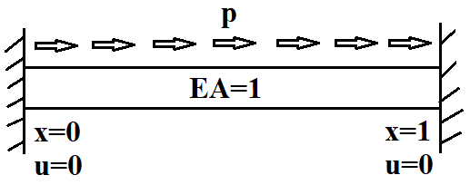

Data driven inference (Forward problem)
Find hidden solution $u(t,x)$ when coefficients $λ$ are known.
Static Model
Static Bar problem: $\frac{∂u}{∂t}=0$
$u\left(x\right)= ?$
The system can be expressed by, $\frac{d}{dx}\left(EA\frac{du}{dx}\right)+p=0 on Ω,$
$EA\frac{du}{dx}=F on Γ_{N}$,
$u=g on{ Γ}_{D}.$
Young’s modulus $E(x)$ and Cross-sectional area $A(x)$ both may vary with $x$

Slide 6
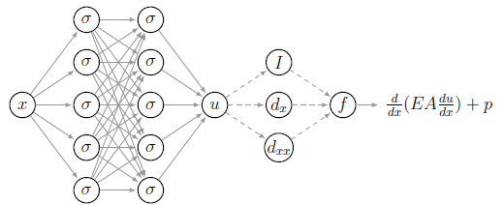

Neural Network :
A physics informed neural network approximates the displacement $u(x)$.
The solution is known at $x=0$ and $x=1$.
Additionally the governing equation has to be satisfied for every point in the domain. So the network is extended to compute, $f≔\frac{d}{dx}\left(EA\frac{du}{dx}\right)+p$

Slide 7
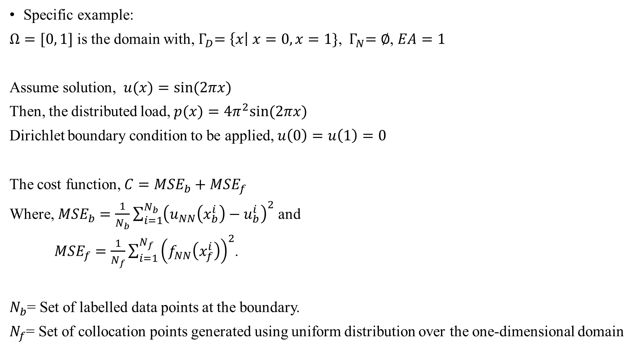
Specific example:
$Ω=[0, 1]$ is the domain with,${ Γ}_{D}=\left\{x\right| x=0, x=1\}$, ${ Γ}_{N}=∅$, $EA=1$
Assume solution, $u(x)=sin⁡(2πx)$
Then, the distributed load, $p(x)=4π^{2}sin⁡(2πx)$
Dirichlet boundary condition to be applied, $u\left(0\right)=u\left(1\right)=0$
The cost function, $C={MSE}_{b}+{MSE}_{f}$
Where, ${MSE}_{b}=\frac{1}{N_{b}}\sum_{i=1}^{N_{b}}{{\left(u_{NN}\left(x_{b}^{i}\right)−u_{b}^{i}\right)}^{2}}$ and
${MSE}_{f}=\frac{1}{N_{f}}\sum_{i=1}^{N_{f}}{{\left(f_{NN}\left(x_{f}^{i}\right)\right)}^{2}}$.
$N_{b}$= Set of labelled data points at the boundary.
$N_{f}$= Set of collocation points generated using uniform distribution over the one-dimensional domain

Slide 8
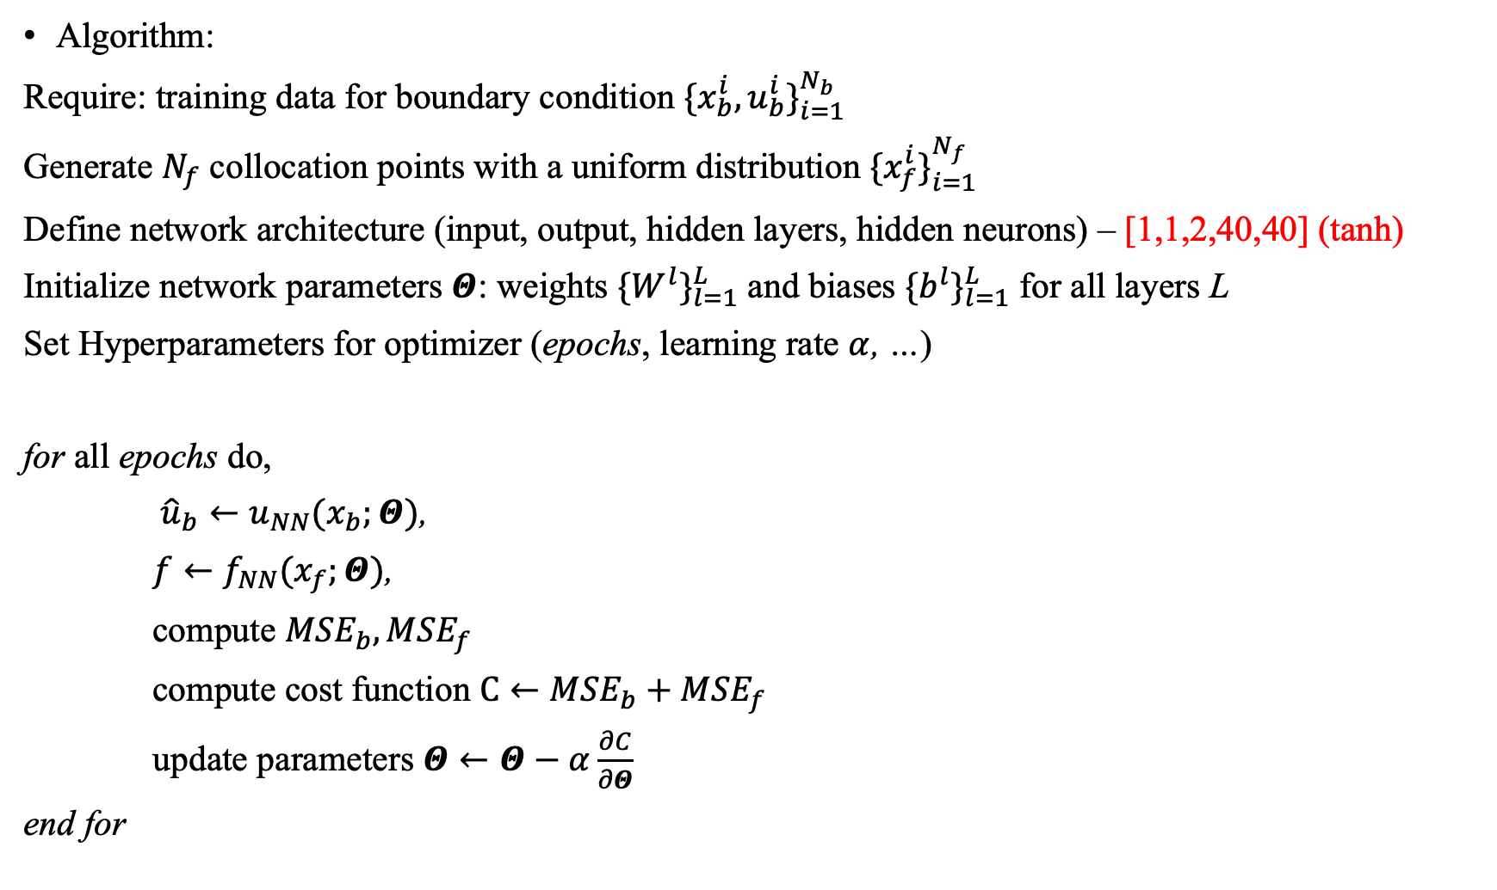
Algorithm:
Require: training data for boundary condition ${\{x_{b}^{i},u_{b}^{i}\}}_{i=1}^{N_{b}}$
Generate $N_{f}$ collocation points with a uniform distribution ${\{x_{f}^{i}\}}_{i=1}^{N_{f}}$
Define network architecture (input, output, hidden layers, hidden neurons) – [1,1,2,40,40] (tanh)
Initialize network parameters $Θ$: weights ${\{W^{l}\}}_{l=1}^{L}$ and biases ${\{b^{l}\}}_{l=1}^{L}$ for all layers L
Set Hyperparameters for optimizer (epochs, learning rate $α$, …)
for all epochs do,
${\hat{u}}_{b}←u_{NN}(x_{b};Θ)$,
$f←f_{NN}(x_{f};Θ)$,
compute ${MSE}_{b},{MSE}_{f}$
compute cost function $C←{MSE}_{b}+{MSE}_{f}$
update parameters $Θ←Θ−α\frac{∂C}{∂Θ}$
end for

Slide 9
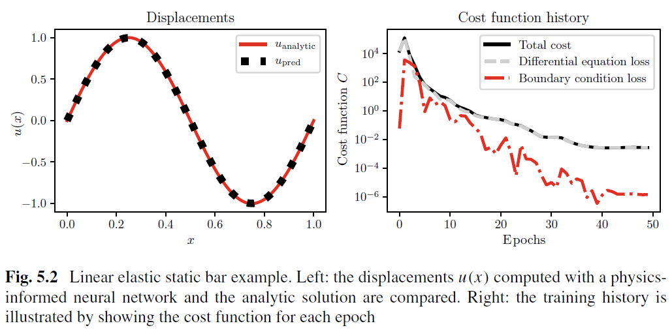
Result:

Slide 10
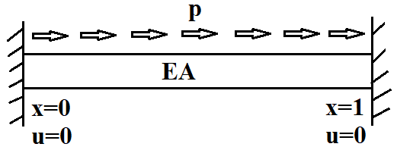

Data driven identification (Inverse problem)
Find coefficients $λ$ when hidden solution $u(t,x)$ are known.
Static Model
Static Bar problem: $\frac{∂u}{∂t}=0$
$EA\left(x\right)= ?$
The system can be expressed by, $\frac{d}{dx}\left(EA\frac{du}{dx}\right)+p=0 on Ω,$
$EA\frac{du}{dx}=F on Γ_{N}$,
$u=g on{ Γ}_{D}.$
Young’s modulus $E(x)$ and Cross-sectional area $A(x)$ both may vary with $x$

Slide 11
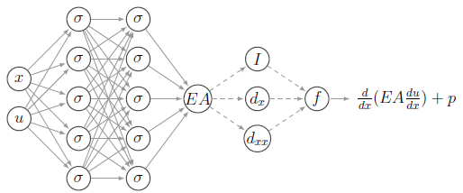

Neural Network :
A physics informed neural network approximates the stiffness parameter EA$(x)$.
The solution is known at $x=0$ and $x=1$. But boundary conditions have no influence over learning of model parameters.
Additionally the governing equation has to be satisfied for every point in the domain. So the network is extended to compute, $f≔\frac{d}{dx}\left(EA\frac{du}{dx}\right)+p$

Slide 12
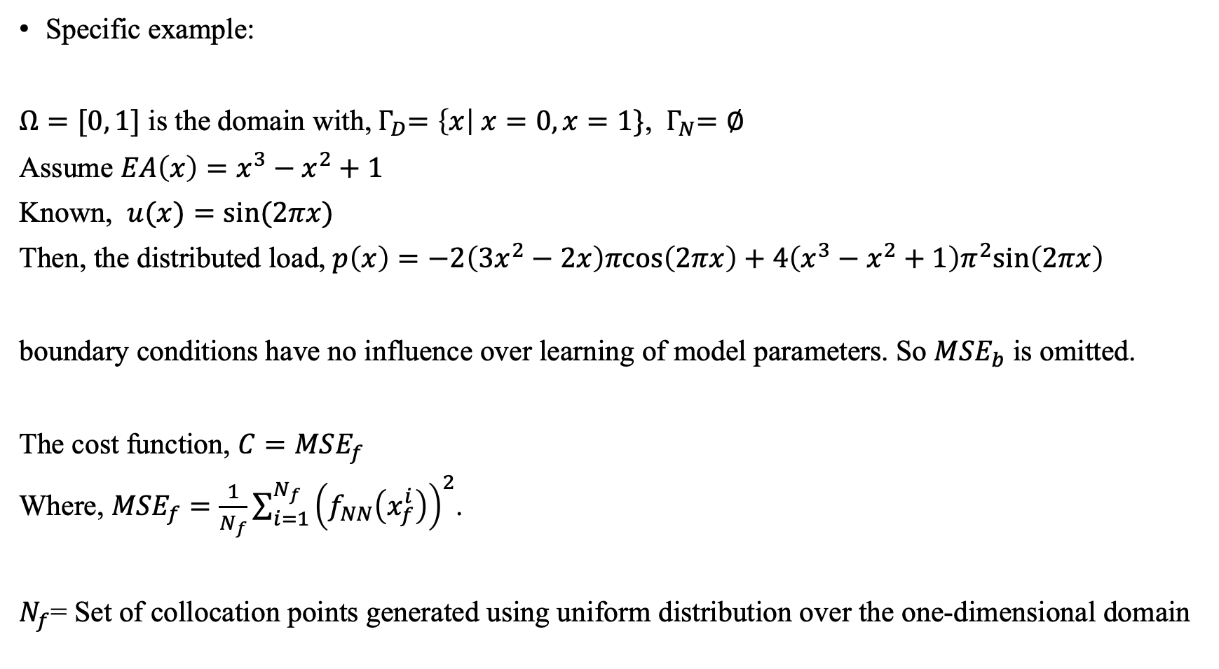
Specific example:
$Ω=[0, 1]$ is the domain with,${ Γ}_{D}=\left\{x\right| x=0, x=1\}$, ${ Γ}_{N}=∅$
Assume $EA\left(x\right)=x^{3}−x^{2}+1$
Known, $u(x)=sin⁡(2πx)$
Then, the distributed load, $p\left(x\right)=−2\left(3x^{2}−2x\right)πcos\left(2πx\right)+4\left(x^{3}−x^{2}+1\right)π^{2}sin\left(2πx\right)$
boundary conditions have no influence over learning of model parameters. So ${MSE}_{b}$ is omitted.
The cost function, $C={MSE}_{f}$
Where, ${MSE}_{f}=\frac{1}{N_{f}}\sum_{i=1}^{N_{f}}{{\left(f_{NN}\left(x_{f}^{i}\right)\right)}^{2}}$.
$N_{f}$= Set of collocation points generated using uniform distribution over the one-dimensional domain

Slide 13
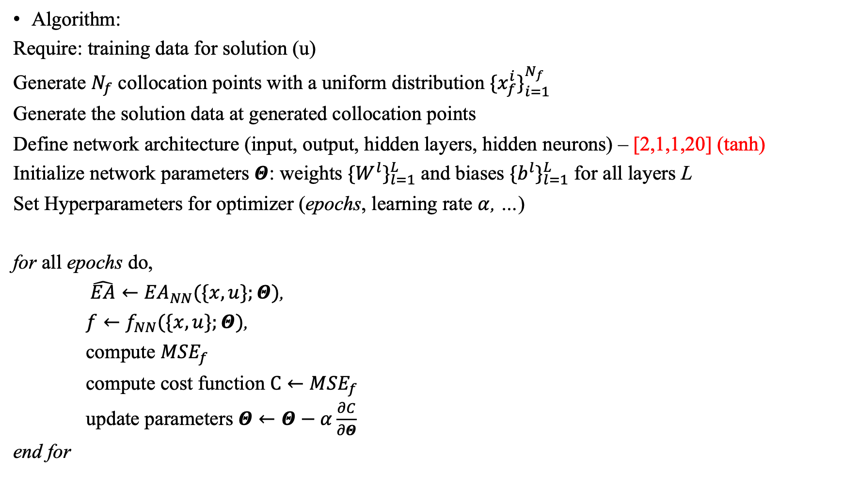
Algorithm:
Require: training data for solution (u)
Generate $N_{f}$ collocation points with a uniform distribution ${\{x_{f}^{i}\}}_{i=1}^{N_{f}}$
Generate the solution data at generated collocation points
Define network architecture (input, output, hidden layers, hidden neurons) – [2,1,1,20] (tanh)
Initialize network parameters $Θ$: weights ${\{W^{l}\}}_{l=1}^{L}$ and biases ${\{b^{l}\}}_{l=1}^{L}$ for all layers L
Set Hyperparameters for optimizer (epochs, learning rate $α$, …)
for all epochs do,
$\hat{EA}←{EA}_{NN}(\{x,u\};Θ)$,
$f←f_{NN}(\{x,u\};Θ)$,
compute ${MSE}_{f}$
compute cost function $C←{MSE}_{f}$
update parameters $Θ←Θ−α\frac{∂C}{∂Θ}$
end for

Slide 14
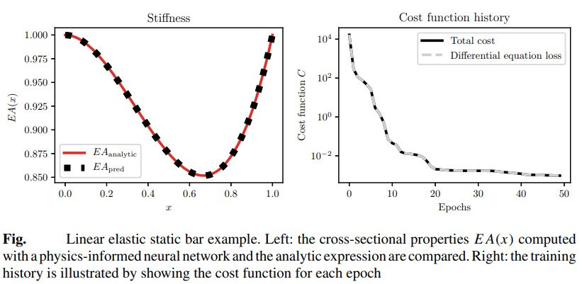
Result:

